Slide 1
Adding Redis Caching
To Your .NET Web API
Jonathan "J." Tower

Slide 2

Notes:
Recently a client of ours at Trailhead came to us with a web application build with ASP.NET that was going very slow
Their users we regularly clicking buttons and then waiting between 10 seconds and 2 minutes for the backend processes to complete
While they just sat and watched a spinner animation
As always, there was no silver bullet or single solution that solved all of the application’s performance problems
But there was one that had a bigger impact than all the others, and that was to add a Redis cache to the application
You see, after some quick research, we discovered that the database server was the primary bottleneck in this application
Unfortunately, due to some bad design decisions early in the life of the application,
the front-end application made frequent calls to the API and database for data that hardly ever changed
User permissions, profile pictures, certain lookup data to populate dropdown lists throughout the application…
Each of these calls would happen any time a user took any application in the system
Even if that data was just retrieved moments earlier
Once we added this commonly-accessed data to a Redis cache….

Slide 3

Notes:
the application immediately sped up
By taking a lot of load off the database by moving these frequently calls for infrequently-changing data to Redis
We gave the database more processing power to focus on other tasks, speeding those tasks up as well

Slide 4
Speed Up Your .NET Application with Redis Caching
Notes:
Today I’m going to show you how YOU can use Redis to speed up your .NET applications

Slide 5

Hi, I’m J.
Jonathan "J." Tower
Principal Consultant & Partner
Trailhead Technology Partners
trailheadtechnology.com
 Microsoft MVP in .NET
✓ Organizer of Beer City Code
→ jtower@trailheadtechnology.com
✶ trailheadtechnology.com/blog
 jtowermi
https://github.com/jonathantower/redis-aspnet-core
Notes:
My name is Jonathan Tower, but my friends call me J
I’m a 7-time recipient of the Microsoft MVP award in .NET
And founding partner at Trailhead Technology Partners,
Where we help our clients architect and build their microservice projects ever day
Over my 24 years of professional experience, I’ve either seen or made just about every architectural mistake that can be made, and today I’ll share that experience with you
As it relates to building microservices correctly

Slide 6
Overview
Definitions
Why Use Caching
Getting Started in ASP.NET Core
The Redis Command Line Interface
ASP.NET Core Redis Demo
Common Mistakes
Caching
Redis
ConnectionMultiplexer
IDistributedCache
StackExchange.Redis
ServiceStack.Redis

Slide 7



BUT FIRST…If You Give $200, So Will I!
bit.ly/lou22-water
“charity:water is a non-profit organization that provides clean and safe drinking water to people in developing nations. The organization was founded in 2006 and has helped fund 35,000 projects in 27 countries, benefiting over 9.5 million people..” - Wikipedia
“4/4 Stars” - CharityNavigator.org

Slide 8
What is Caching?

Slide 9

Notes:
You might have heard the term “cache” or “caching” in relationship to something else. In the autumn, squirrels collect and hide a hoard of nuts and seeds which they return to and retrieve as needed throughout the winter. The hoard is called a cache, and the activity is called caching.
In general, the verb cache means to “store away in hiding or for future use”

Slide 10

Notes:
which I guess can apply equally well to both squirrels and developers

Slide 11
What is Caching?
Temporarily storing frequently accessed data to fast storage that’s located close to the application

Slide 12
What is Caching?
Temporarily storing frequently accessed data to fast storage that’s located close to the application
Notes:
Temporarily – values in cache are not the primary respresentations of those data, but are temporary copies set to expire after some time or event

Slide 13
What is Caching?
Temporarily storing frequently accessed data to fast storage that’s located close to the application
Notes:
Caching works best when it’s used on frequently accessed data that changes infrequently:
Lookups like statuses
US States
User permissions
User profile
User photo

Slide 14
What is Caching?
Temporarily storing frequently accessed data to fast storage that’s located close to the application
Notes:
Caching can’t improve performance if it’s not faster than the alternative, so it has to be fast, which usually means in-memory somewhere
Trade off, to be fast it has to be in-memory, but to be in-memory limits how much can be stored

Slide 15
What is Caching?
Temporarily storing frequently accessed data to fast storage that’s located close to the application
Notes:
If the cache is far from the application, especially if it’s connected over a slow connection, it won’t be able to improve performance

Slide 16
What is Redis?

Slide 17

What is Redis?
The open source, in-memory data store used by millions of developers as a database, cache, streaming engine, and message broker.
REmote DIctionary Server

Slide 18
Redis: An In-Memory Dictionary
Dictionary
Dictionary:
An unordered collection of data represented by a set of key-value pairs
Name1
Value1
Name2
Value2
Name3
Value3
…
…

Slide 19
Redis is Not a Relational DB
Key/Value pairs
Size limit
In-memory
Invalidation/expiration

Slide 20

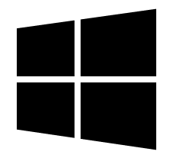
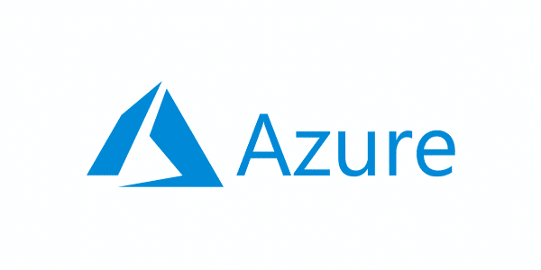

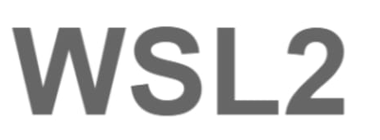



Redis Hosting Options
Self-Host
Host in Managed Cloud

Slide 21
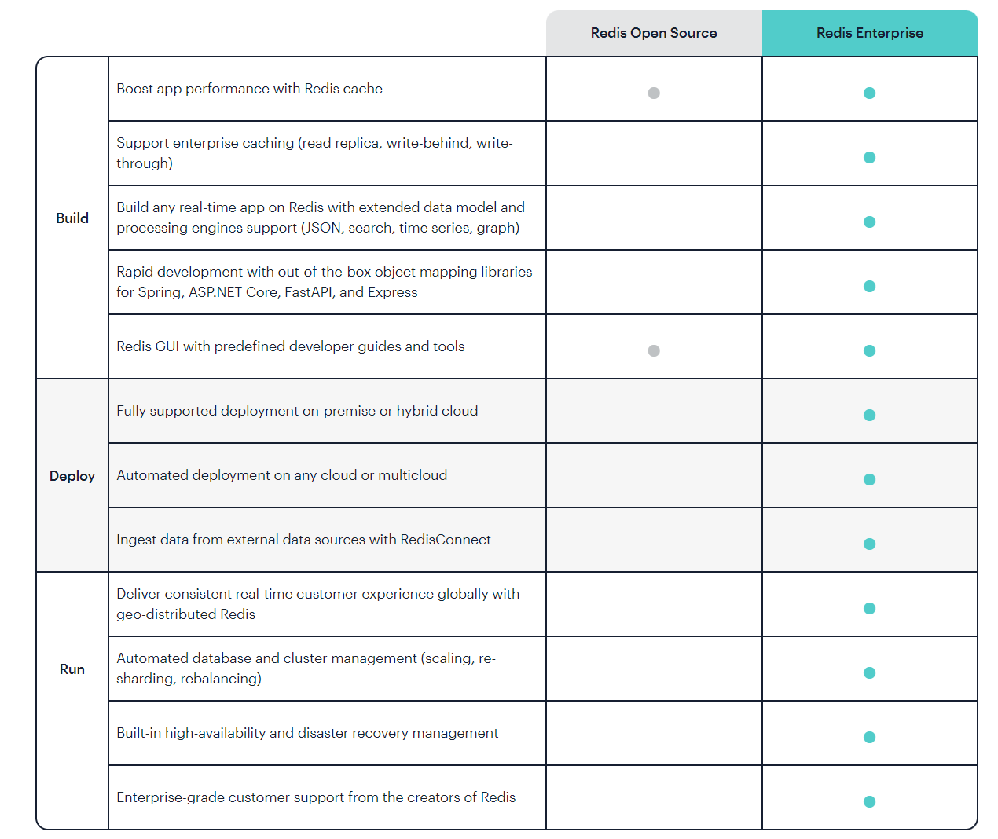
Redis SKUs
Notes:
Take this information with a grain of salt
This is from Redis Enterprise, which is obviously trying to convince you to buy Enterprise
Me: Use Enterprise if you need support, and if you need to support complex clustering scenarios

Slide 22
Reminder…If You Give $200, So Will I!
bit.ly/lou22-water
“charity:water is a non-profit organization that provides clean and safe drinking water to people in developing nations. The organization was founded in 2006 and has helped fund 35,000 projects in 27 countries, benefiting over 9.5 million people..” - Wikipedia
“4/4 Stars” - CharityNavigator.org

Slide 23
Why Use Caching?

Slide 24
Caching Sample
API
GetCountries()
DB
GetProfilePicture()
CreateOrder()
GetCustomerOrders()

Slide 25
Caching Sample
API
GetCountries()
100 / min
DB
GetProfilePicture()
10,000 / min
CreateOrder()
GetCustomerOrders()

Slide 26
Caching Sample
API
GetCountries()
100 / min
DB
GetProfilePicture()
10,000 / min
CreateOrder()
1 / min
5 / min
GetCustomerOrders()

Slide 27
Caching Sample
API
GetCountries()
100 / min
DB
GetProfilePicture()
10,000 / min
CreateOrder()
X
1 / min
5 / min
X
GetCustomerOrders()

Slide 28

Caching Sample
DB
API
100 / min
GetCountries()
1 / hr
10,000 / min
DB
GetProfilePicture()
CreateOrder()
1 / min
5 / min
GetCustomerOrders()

Slide 29
Getting Started
Adding Redis to Your ASP.NET Core Project

Slide 30
ASP.NET vs ASP.NET Core
Possible in both ASP.NET and ASP.NET Core*
*We’ll focus on ASP.NET Core
For more, see:
https://docs.microsoft.com/en-us/azure/azure-cache-for-redis/cache-web-app-howto
https://docs.microsoft.com/en-us/azure/azure-cache-for-redis/cache-web-app-aspnet-core-howto

Slide 31
Redis Setup for Development on Windows
Install WSL2 on Windows
Install Docker Desktop on Windows
docker run --name dev-redis -p 6379:6379 -d redis
Install redis-cli on WSL2
https://redis.io/docs/getting-started/installation/install-redis-on-windows/

Slide 32
Adding Redis to ASP.NET Core
Add StackExchange.Redis nuget package
Either:
Wrapper for SINGLE instance of ConnectionMultiplexer
IDistributedCache through builder.Services.AddStackExchangeRedisCache(…)

Slide 33
StackExchange.Redis vs ServiceStack.Redis
 | StackExchange.Redis | ServiceStack.Redis
Cost | Free | $300 - $1,000 / dev
Support | None | Commercial Support

Slide 34
DEMO
Redis Command Line Interface (CLI)
Notes:
keys *
set key value
get key
del key
flushall

Slide 35
DEMO
User Profile Images

Slide 36
Redis API vs IDistributedCache
Microsoft.Extensions.Caching.StackExchangeRedis nuget package
builder.Services.AddStackExchangeRedisCache(options =>
{
options.Configuration = "127.0.0.1:6379,allowAdmin=true";
options.InstanceName = "dev-redis";
});

Slide 37
Common Mistakes
With Redis Caching

Slide 38
Common Redis Mistakes
One request per connection
Too many ConnectionMultiplexer instances (StackExchange.Redis)
Not using a password
Not expecting cache misses
Updating data too often
Caching infrequently-accessed data
Redis too far from application
Not having a key naming convention

Slide 39
Key Naming Convention
Use colon (:) to separate items
namespace:object-type:id:field
Examples:
user:1000:password
comment:1234:reply.to
Another suggestion (# for ids)
logistics:building#23

Slide 40

Summing Up
Using Redis correctly can speed up your application and take load off your database
Host Redis wherever you want (on-prem, cloud, etc)
Use StackExchange SDK for free or ServiceStack for commercial support
ConnectionMultiplexer or IDistributedCache

Slide 41
Recap
Definitions
Why Use Caching
Getting Started in ASP.NET Core
The Redis Command Line Interface
ASP.NET Core Redis Demo
Common Mistakes
Caching
Redis
ConnectionMultiplexer
IDistributedCache
StackExchange.Redis
ServiceStack.Redis

Slide 42
Last Chance…If You Give $200, So Will I!
bit.ly/lou22-water
“charity:water is a non-profit organization that provides clean and safe drinking water to people in developing nations. The organization was founded in 2006 and has helped fund 35,000 projects in 27 countries, benefiting over 9.5 million people..” - Wikipedia
“4/4 Stars” - CharityNavigator.org

Slide 43
Thank You! Questions?
Jonathan "J." Tower
Principal Consultant & Partner
Trailhead Technology Partners
trailheadtechnology.com
 Microsoft MVP in .NET
✓ Organizer of Beer City Code
→ jtower@trailheadtechnology.com
✶ trailheadtechnology.com/blog
 jtowermi
https://github.com/jonathantower/redis-aspnet-core
Notes:
Introduce self

